Slide 1


Slide 2
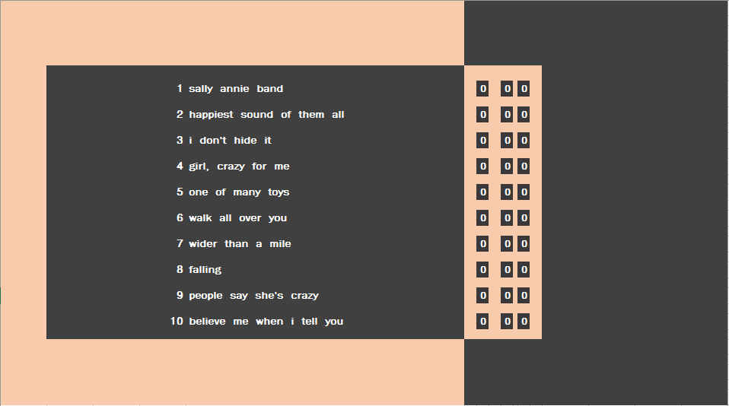

Slide 3
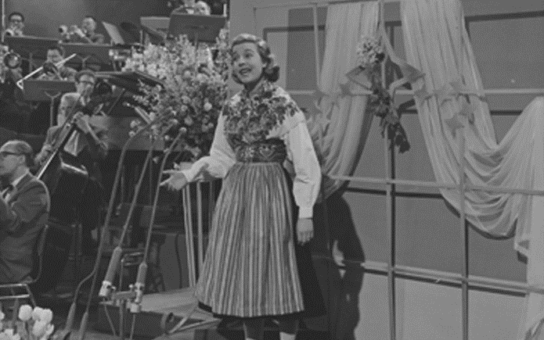

LOLA-ELIZABETH MITCHELL

Slide 4


Slide 5
LOLA-ELIZABETH MITCHELL

Slide 7
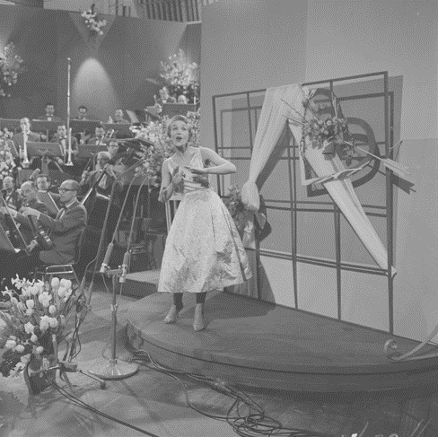
CHLOE HARAWAY

Slide 9
CHLOE HARAWAY

